Slide 1


FAST FOOD
ANALYSIS
PROJECT: CDACL-004-FAST FOOD ANALYSIS
DATA ANAlysis & Visualization using SQL, Excel and Power BI
Prepared by: Pranjali Pawar

Slide 2
PROJECT OVERVIEW
The project analyses the nutritional characteristics of eight fast-food restaurants using SQL, Excel, and Power BI. The objective is to compare menu sizes, evaluate nutritional values, identify differences between restaurants, and provide data-driven recommendations for better menu planning.

Slide 3
PROJECT OBJECTIVE
  Compare menu sizes across eight fast-food restaurants.
  Analyse average calories, protein, total fat, sugar, and sodium.
  Identify restaurants with comparatively high or low nutritional values.
  Examine salad availability and the relationship between calories and protein.
  Identify high-calorie and nutritionally significant menu items.
  Develop an interactive Power BI dashboard to support nutritional comparisons.

Slide 4
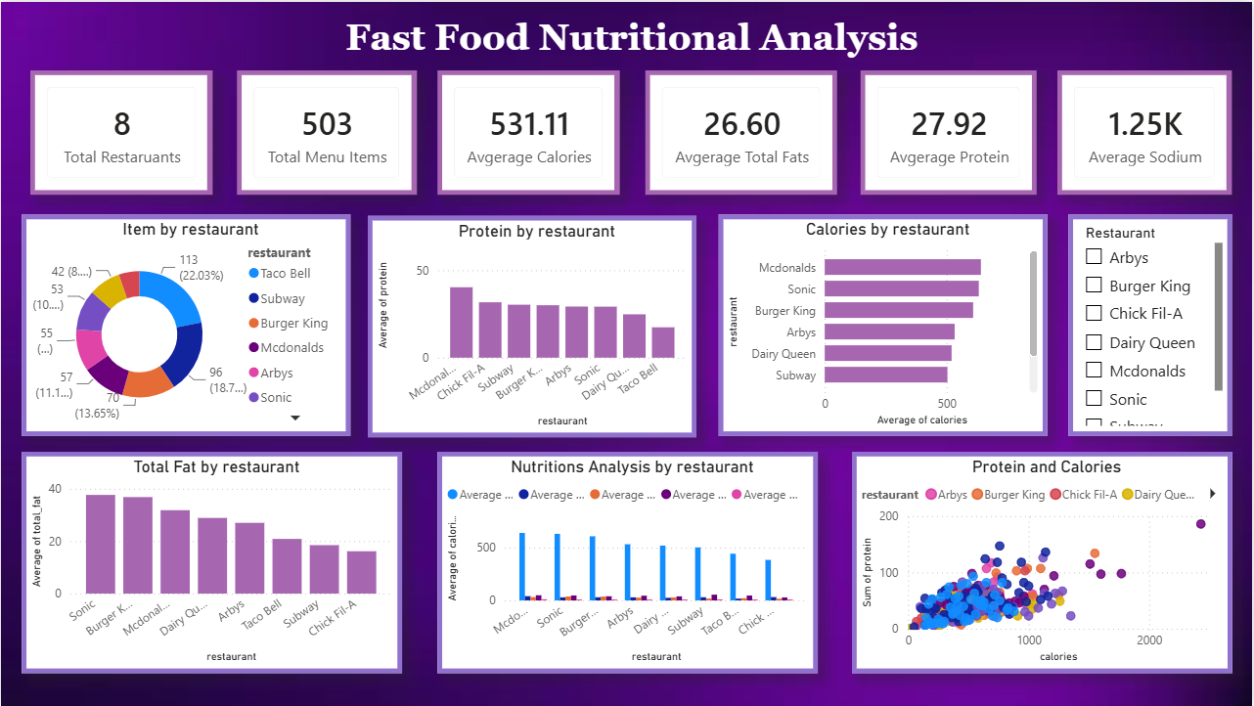
DATASET OVERVIEW
  Restaurants covered: 8
  Menu items analysed: 503
  Key attributes: Restaurant, item, calories, total fat, saturated fat, trans fat, cholesterol, sodium, carbohydrates, fiber, sugar, protein, vitamins, calcium, and salad classification.
  Tools used: MySQL, Microsoft Excel, and Power BI.

Slide 5
DATA PREPARATION & TRANSFORMATION
SQL Analysis
Excel
Power BI
  Data inspection
  Record counts
  Duplicate checks
  Nutritional summaries
  Restaurant-level comparisons.
  Data preparation
  Descriptive statistics
  Average calculations
  Nutritional comparisons.
  Corrected data types
  Interactive dashboards
  KPI cards
  Restaurant comparisons

Slide 6
DASHBORAD OVERVIEW
Menu Size Analysis
  Taco Bell has the largest menu representation, with 113 items.
  Subway follows with 96 items.
  Burger King has 70 items, McDonald's 57, Arby's 55, and Sonic 53.
  Dairy Queen has 42 items.
  Chick-fil-A has the smallest menu representation, with 27 items.
The variation in menu size demonstrates that the restaurants offer different numbers of listed choices. A larger menu does not necessarily indicate better nutritional quality

Slide 7
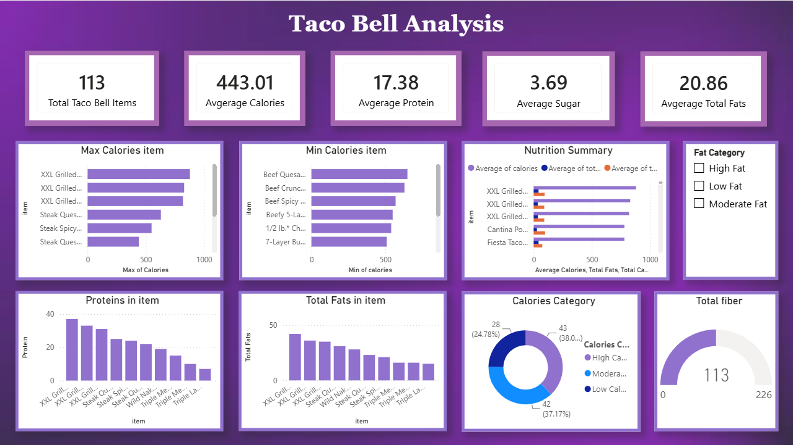
TACO BELL ANALYSIS
Taco Bell Nutritional Analysis
  Total menu items: 113.
  Average calories: 443.01.
  Average protein: 17.38 grams.
  Average sugar: 3.69 grams.
  Average total fat: 20.86 grams.
The Taco Bell dashboard compares high- and low-calorie items, protein and total fat across menu items, calorie categories, and selected nutritional indicators. These comparisons help identify items that may warrant further nutritional evaluation.

Slide 8
OVERALL NUTRITIONAL FINDINGS
RESTAURANT PERFORMANCE ANALYSIS
  The average calorie content across the analysed menu items is approximately 531.11 calories.
  The average total fat content is approximately 26.60 grams per item.
  The average protein content is approximately 27.92 grams per item.
  The average sodium content is approximately 1.25K milligrams per item.
  Nutritional values vary considerably across restaurants and individual menu items.
  McDonald's has the highest average calorie content at approximately 640 calories per item.
  Sonic follows at approximately 632 calories, while Burger King averages approximately 609 calories.
  Taco Bell has an average calorie content of 443.01 calories per item.
  Sonic has the highest average total fat content at approximately 38 grams per item, followed by Burger King at approximately 37 grams.
  McDonald's has the highest average protein content visible in the dashboard comparison.

Slide 9
HIGHEST CALORIE ITEMS
Key observations
  The highest-calorie menu items contain considerably more calories than the average menu item.
  Several grilled and steak-based items appear among the highest-calorie options in the dashboard.
  Comparing the lowest-calorie items with the highest-calorie options helps customers understand the variation in the menu's energy content.

Slide 10
NUTRITIONAL COMPARISON
  The nutritional summary compares calories, total fat, and other selected nutritional measures across menu items.
  The chart highlights substantial differences in calorie content between menu options.
  Reviewing multiple nutritional indicators together helps identify items that may be more suitable for different dietary preferences.

Slide 11
PROTEIN & TOTAL FATS
  The average protein content across the analysed Taco Bell menu items is 17.38 g.
  The protein chart shows that protein levels vary across individual menu items.
  The average total fat content is 20.86 g per menu item.
  Comparing total fat alongside calories and protein provides a more balanced understanding of the nutritional profile of each item.
  The category chart show groups menu items into High calorie, moderate calorie, and low calorie categories groups.
  This classification makes it easier to compare menu items based on their energy content.

Slide 12
CALORIES AND PROTEIN RELATIONSHIP
The scatter plot indicates a general positive relationship between calories and protein for some menu items. However, the points are widely distributed, suggesting that protein alone does not explain calorie content.
Differences in fat, carbohydrates, portion sizes, and ingredients may also contribute to calorie variation. Individual menu items should therefore be compared using multiple nutritional measures.

Slide 13
DIAGNOSTIC FINDINGS
  Menu sizes vary considerably between the eight restaurants.
  Average calorie and fat values differ across restaurant menus.
  Individual menu items can have nutritional values substantially different from their restaurant's average.
  High protein content does not automatically indicate low calorie content.
  Restaurant-wide averages are useful for comparison but should be supported by item-level analysis.
  Salad classification alone does not establish whether an item is nutritionally balanced.

Slide 14
BUSINESS SUGGESTIONS
  Provide clear nutritional information for calories, protein, fat, sugar, and sodium.
  Review high-calorie and high-fat menu items to identify opportunities for improvement.
  Consider lower-sodium and lower-sugar alternatives where appropriate.
  Expand balanced menu choices that combine suitable protein content with moderate calories and fat.
  Evaluate individual items instead of relying exclusively on restaurant-wide averages.
  Use interactive dashboards to monitor nutritional performance and support data-driven menu planning.

Slide 15
CONCLUSION
The analysis demonstrates how SQL, Excel, and Power BI can be combined to evaluate fast-food menu characteristics and nutritional differences. Taco Bell has the largest menu representation in the dataset, while McDonald's, Sonic, and Burger King show comparatively high average calorie values. Sonic and Burger King also have comparatively high average total fat values.
The findings support the use of data-driven nutritional comparisons to identify items for further review, improve nutritional transparency, and evaluate opportunities for more balanced menu options.

